Slide 1
Got It Ops Exercise
Root cause analysis of low star ratings in October’s Week 4
Ray (Hung Pham) March 12, 2023

Slide 2
Initial Hypotheses & Data Requirement
No. | Hypothesis | Data Requirement
1 | Recruitment Process: criteria of expert backgrounds during recruitment may not be clearly defined | Backgrounds, experience, expert rank, user ratings
2 | Expert Service Quality: experts may be inadequately trained to meet user expectations | Expert performance evaluation during training, number of completed sessions, login duration, user ratings
3 | Auditing System: our auditing system may have failed to detect and decertify many low-rated experts | Auditing system’s configurations and recent releases
4 | Newly Introduced Features: users & experts may need time to adapt to new updates | Users and experts’ feedback to Customer Support team
5 | Follow-Up With Users: post-session communication with users may be lacking | Users’ reasons for low star ratings

Slide 3
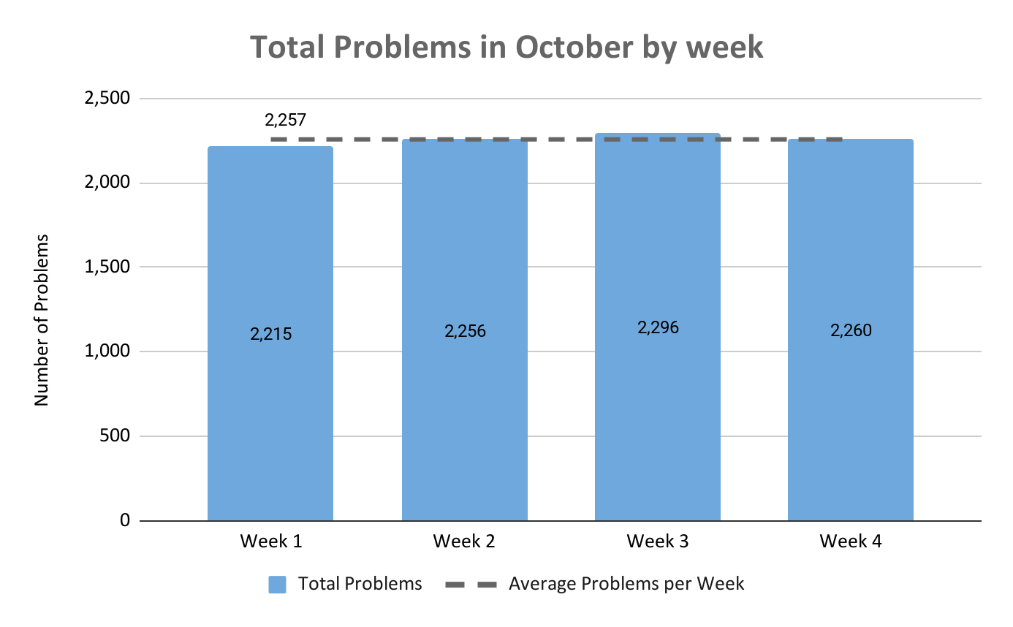
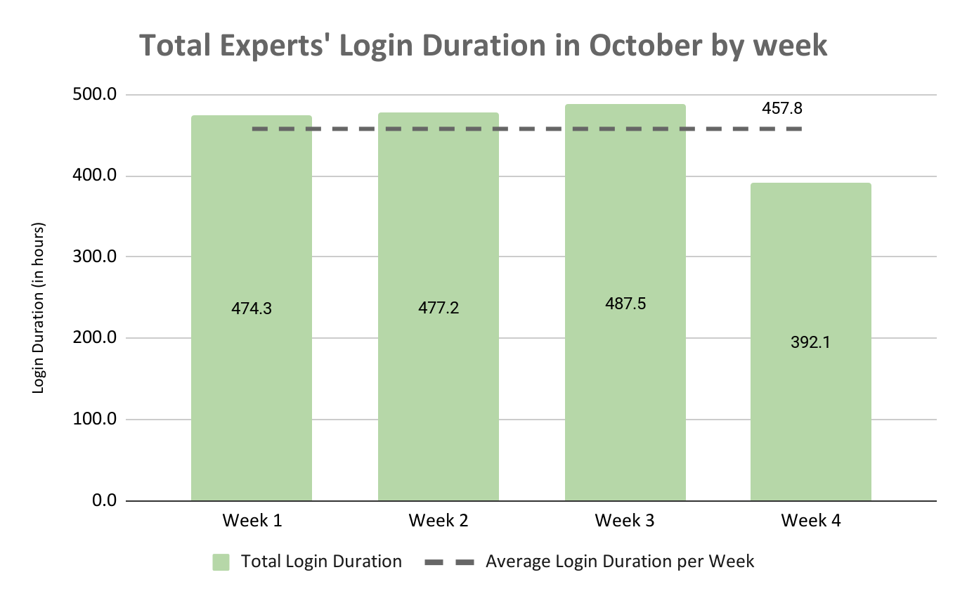
General Analysis
Total problems remained stable throughout the 4 weeks.
However, login duration time saw a noticeable decline in Week 4.

Slide 4
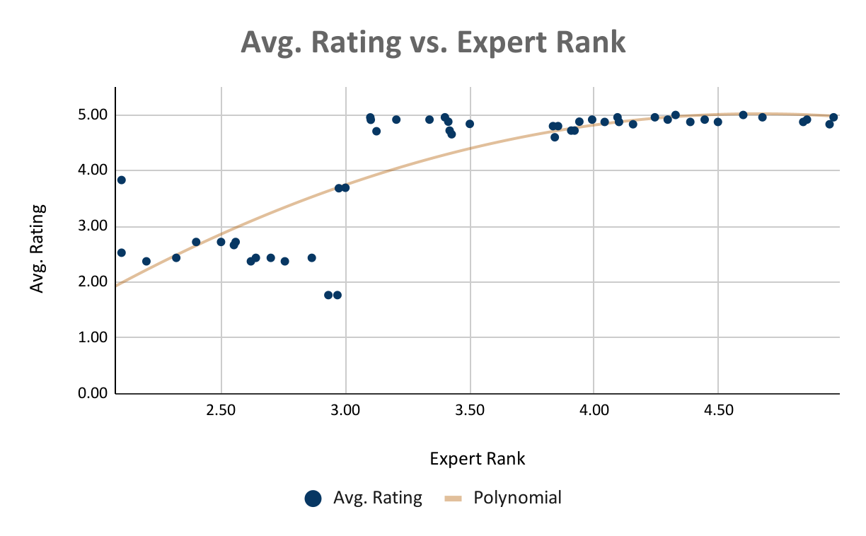
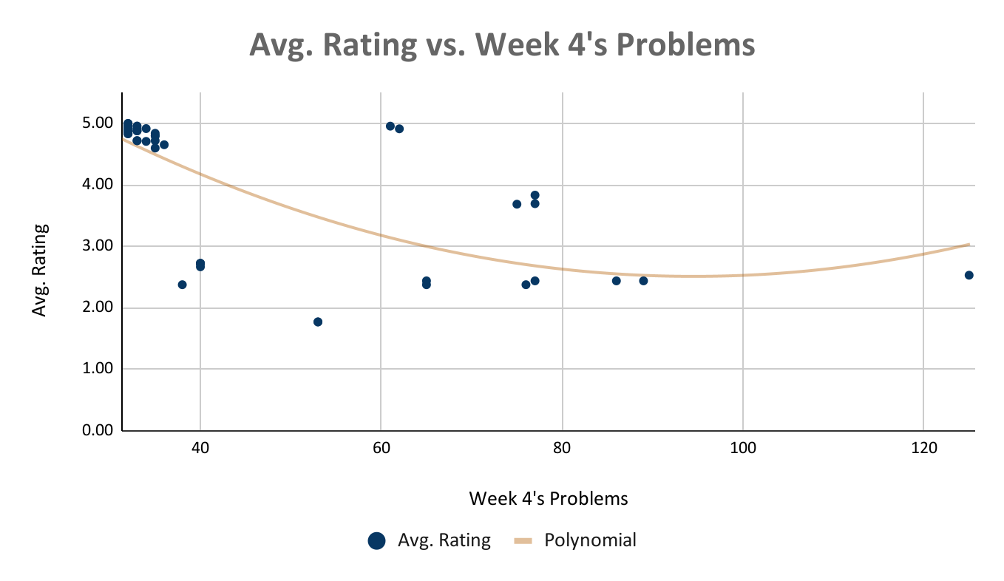
Correlation Analysis
 | Expert Rank | Avg. Rating
Expert Rank | 1 | 0.7732
Avg. Rating | 0.7732 | 1
 | Week 4's Prob. | Avg. Rating
Week 4's Prob. | 1 | -0.6446
Avg. Rating | -0.6446 | 1
y = -0.462x² + 4.31x - 5.02
R² = 0.667
y = 7.52 + -0.106x + 5.6E-04x²
R² = 0.495
66.7% of Avg. Rating can be explained by this model.
Experts ranked > 3.00 earned more 4 and 5-star ratings.
Experts ranked <= 3.00 had more 1, 2, and 3-star ratings.
49.5% of Avg. Rating can be explained by this model.

Slide 5
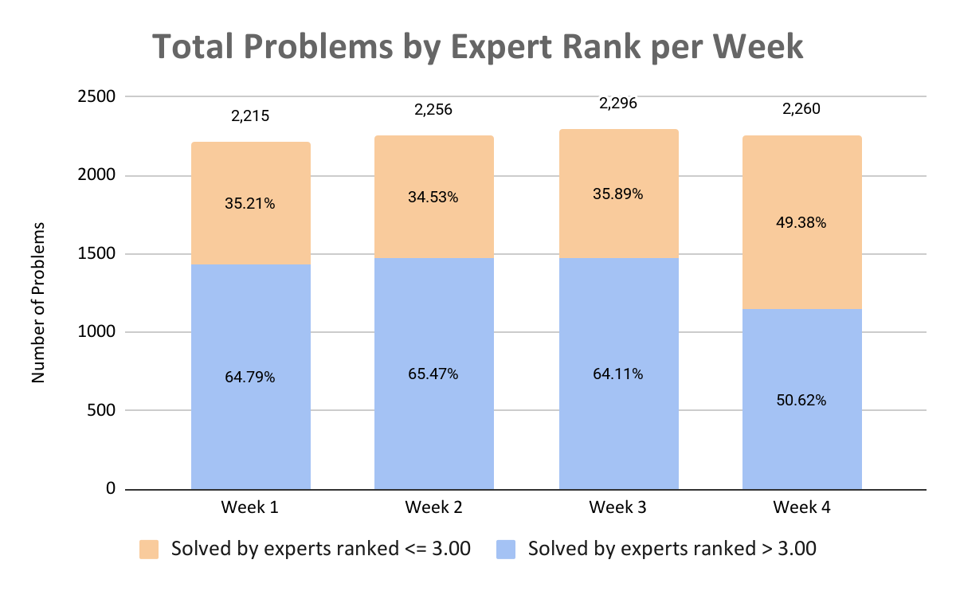
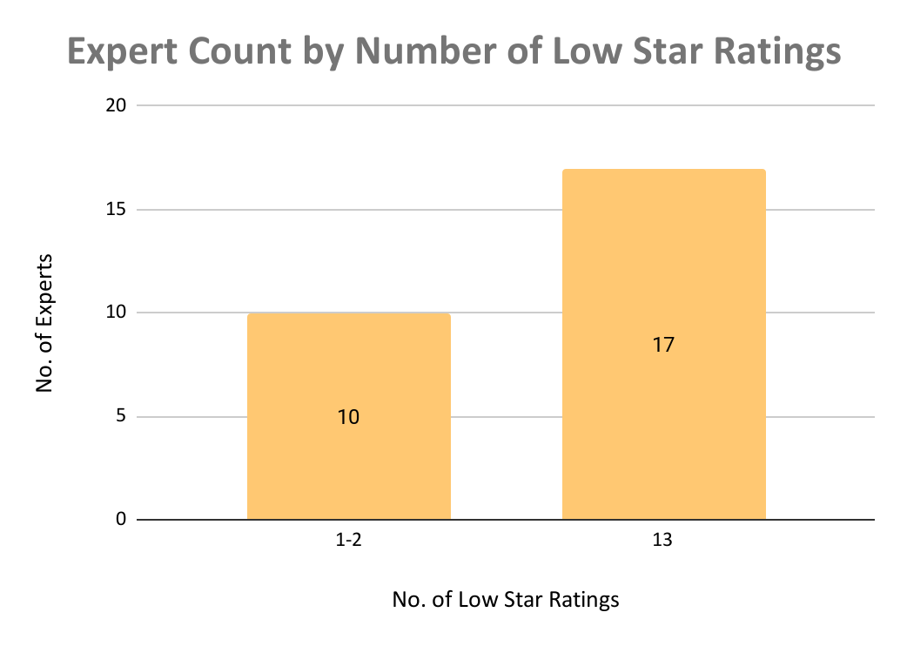
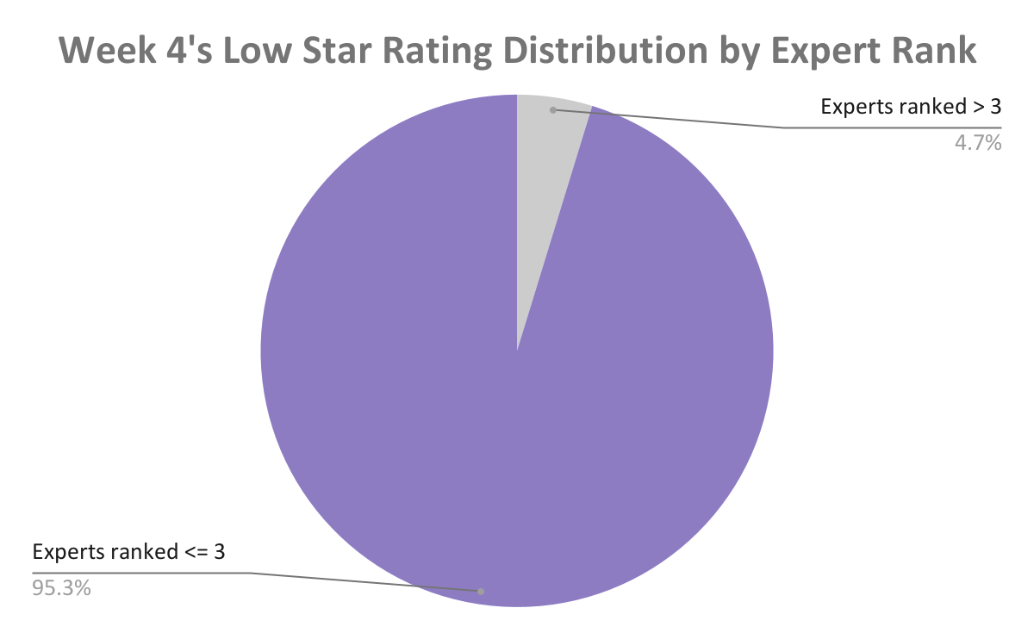
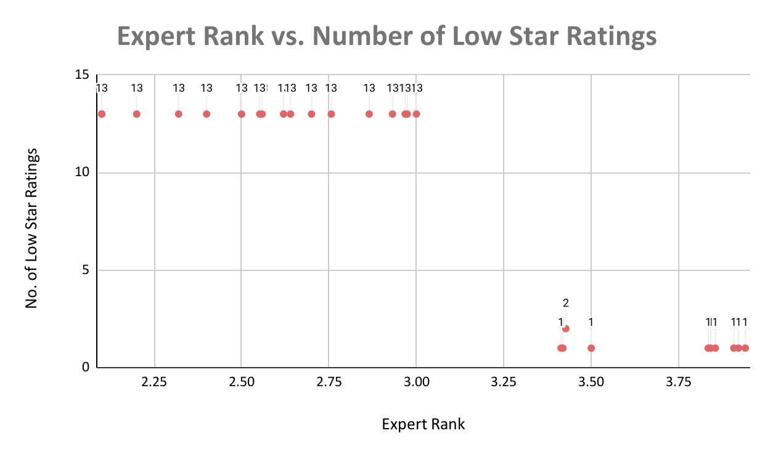
Further Investigation
Problems solved by experts ranked <= 3 sharply increased compared to the previous weeks.
All experts ranked <= 3 with low star ratings in Week 4 had the exact same number of 13 low star ratings.

Slide 6
Initiatives
Troubleshoot auditing system configuration issues
1
Check users’ reasons for low star ratings
2
Update our expert training program
3
Reduce number of unrated sessions
4

Slide 7
Thank you for listening!

